Slide 1
Chapter 3
Discrete Random Variables
and
Their Probability Distributions

Slide 2
Objectives
Moments
Moment Generating Function

Slide 3
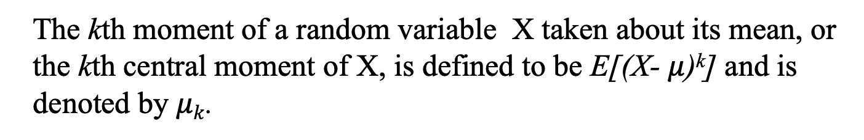
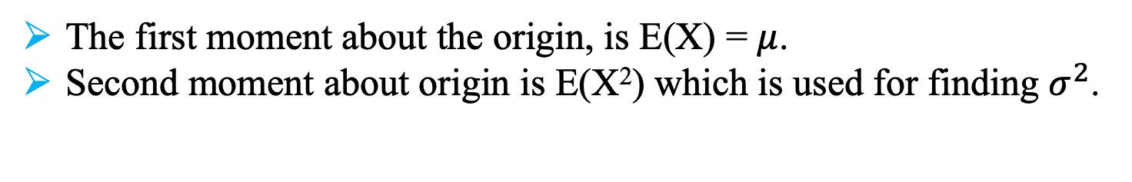
Moments
The kth moment of a random variable X taken about the origin is
defined to be E(X^{k}).
The first moment about the origin, is E(X) = $μ$.
Second moment about origin is E(X²) which is used for finding $σ^{2}$.
The kth moment of a random variable X taken about its mean, or
the kth central moment of X, is defined to be E[(X- $μ$)^{k}] and is
denoted by $μk$.
In particular, the second central moment is E[(X- $μ$)²] = $σ^{2}$.

Slide 4
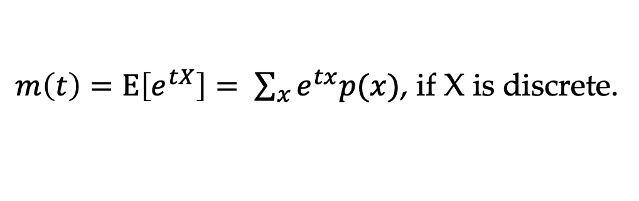
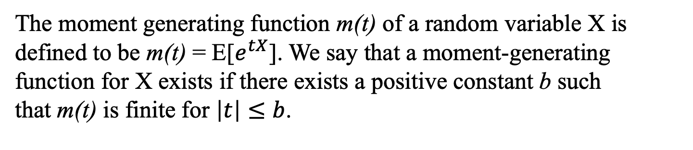
MGF
The moment generating function m(t) of a random variable X is defined to be m(t) = E[$e^{tX}$]. We say that a moment-generating function for X exists if there exists a positive constant b such that m(t) is finite for $\left|t\right|≤b$.
$m\left(t\right)=E\left[e^{tX}\right]= \sum_{x}{e^{tx}p(x)}$, if X is discrete.

Slide 5
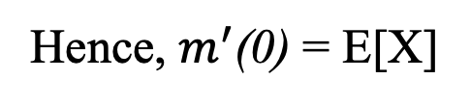
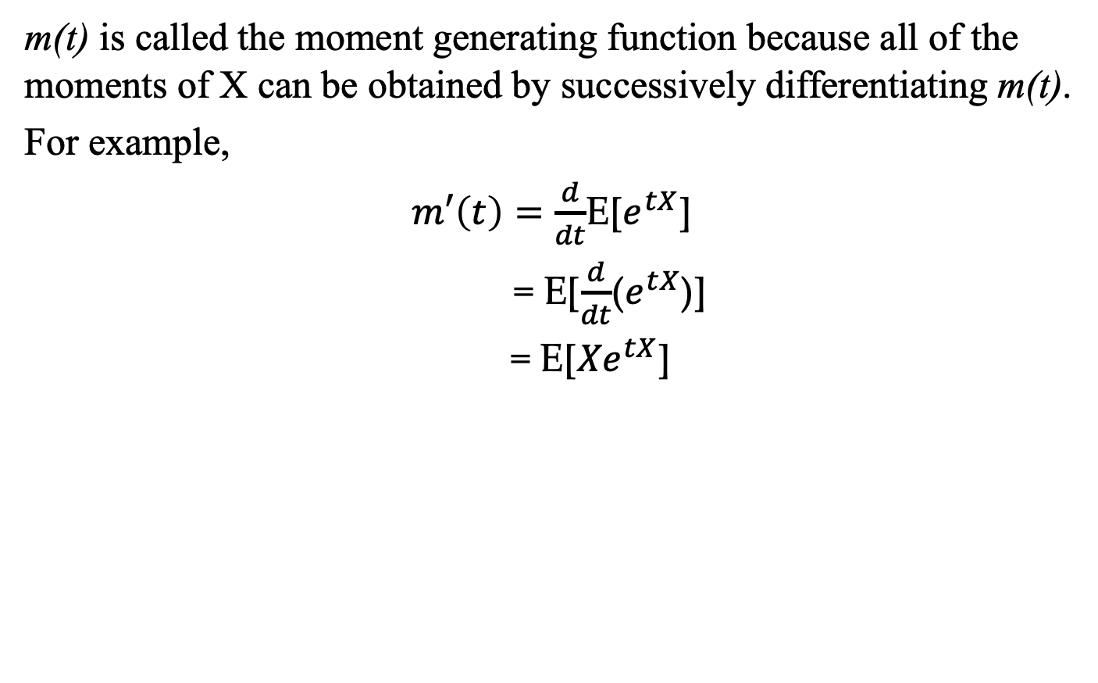
MGF
m(t) is called the moment generating function because all of the moments of X can be obtained by successively differentiating m(t).
For example,
$m′\left(t\right)=\frac{d}{dt}$E[$e^{tX}$]
= E[$\frac{d}{dt}$($e^{tX}$)]
= E[${Xe}^{tX}$]
Hence, $m^{′}$(0) = E[X]

Slide 6
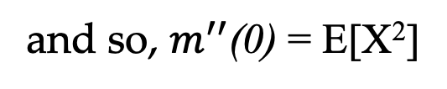
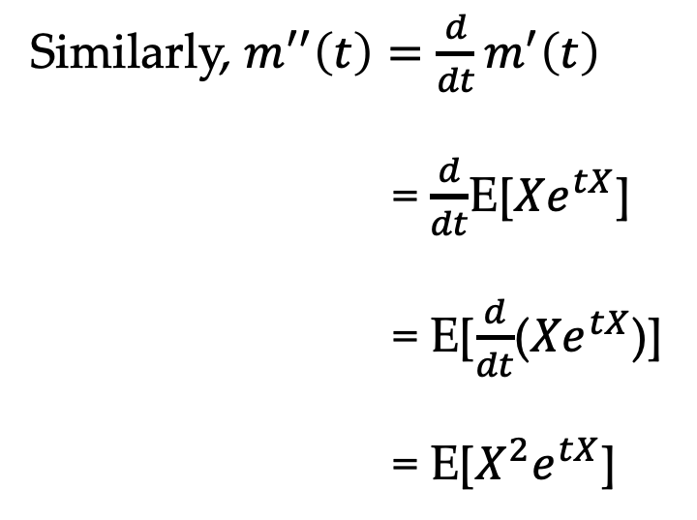
MGF
Similarly, $m^{′′}\left(t\right)=\frac{d}{dt}m^{′}\left(t\right)$
= $\frac{d}{dt}$E[${Xe}^{tX}$]
= E[$\frac{d}{dt}$(${Xe}^{tX}$)]
= E[$X^{2}e^{tX}$]
and so, $m^{′′}$(0) = E[X²]

Slide 7

MGF
In general, the nth derivative of m(t) evaluated at t = 0 equals E[X^{n}], that is,
m^{n}(0) = E[X^{n}], n $≥1$
Note: The moment generating function uniquely determines the distribution. That is, there exists a one-to-one correspondence between the moment generating function and the distribution function of a random variable.

Slide 8
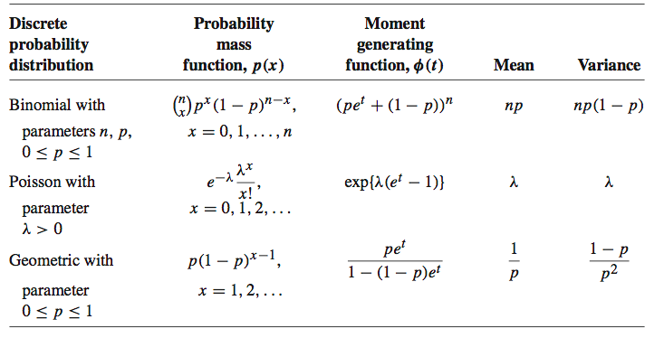
MGF

Slide 9
Supplemental Information
https://towardsdatascience.com/moment-generating-function-explained-27821a739035

